Slide 2
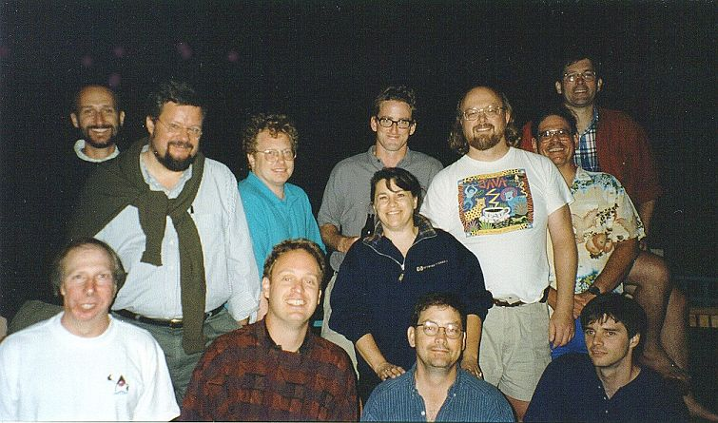
Inventors of JAVA(Oak)

Slide 3
Need of object-oriented approach
The Object-Oriented Approach (OOA) is a programming paradigm that organizes software design around objects, rather than functions or logic.
The main goal of using an object-oriented approach is to make code more reusable, maintainable, and easier to understand by organizing it into discrete entities (objects).

Slide 4
Modeling Real-World Entities
Encapsulation
Inheritance
Polymorphism
Abstraction
Code Reusability
Maintainability
Modularity

Slide 5
1. Modeling Real-World Entities
In the object-oriented approach, everything is represented as objects. These objects model real-world entities or concepts. For example, in a car simulation program, objects could represent cars, engines, and wheels, each with properties and behaviors (methods).
This makes it easier to map a system to the real world, making the system more intuitive to understand.

Slide 6
Encapsulation
Encapsulation refers to bundling the data (attributes) and the methods (functions) that operate on the data into a single unit (class).
It hides the internal implementation details and exposes only what is necessary, improving security and reducing complexity.
For example, in a class BankAccount, we might have methods like deposit() or withdraw(), but the actual data on the account balance is hidden and can only be modified via these methods.

Slide 7
Inheritance
Inheritance allows a class (child class) to inherit properties and methods from another class (parent class). This leads to code reuse and can represent hierarchical relationships.
For instance, a Dog class could inherit from a Animal class, meaning the dog would have all the characteristics of an animal (like eat() and sleep()) and could also have its own unique behavior (like bark())

Slide 8
Polymorphism
Polymorphism allows objects of different classes to be treated as objects of a common superclass. It enables a single method or operation to work with different types of objects.
For example, a method makeSound() could work for both a Dog and a Cat object, even though the actual behavior would be different (barking vs meowing)

Slide 9
Abstraction
Abstraction allows complex systems to be represented with simplified interfaces. It hides the unnecessary details and exposes only the essential features.
A good example is the use of a Car class with methods like start() and stop(), where the complex workings of the car's engine are hidden from the user of the class.

Slide 10
6. Code Reusability
Classes can be reused across different projects or parts of an application, significantly improving the efficiency of development.
Once a class is created, it can be instantiated multiple times to create objects with similar characteristics, saving developers from writing repetitive code.

Slide 11
Maintainability
Code in an object-oriented system is easier to modify and extend. Since classes and objects are well-defined, changes can often be made with minimal impact on other parts of the system.
For example, changing how a BankAccount works internally will not affect the other classes that interact with it, as long as the interface remains the same.

Slide 12
Example in OOP:
Let’s say you are building a software system to simulate a zoo. Here's how OOP might help:
Classes & Objects
Animal (superclass) – defines general properties and behaviors of animals (e.g., name, age, eat(), sleep()).
Lion and Elephant (subclasses) – inherit from Animal, with specific behaviors like roar() for the lion and trumpet() for the elephant.
Encapsulation
Animal has properties like name and age, but you can't directly modify the age without using the grow() method.
Inheritance
Lion and Elephant classes inherit general animal behavior from the Animal class but also define their own specific methods (like roar() for Lion).
Polymorphism
Both Lion and Elephant can implement the makeSound() method differently, but you can treat both objects as Animal objects and call makeSound() without knowing what specific animal the object represents.

Slide 13
Comparison of C++ and Java

Slide 14
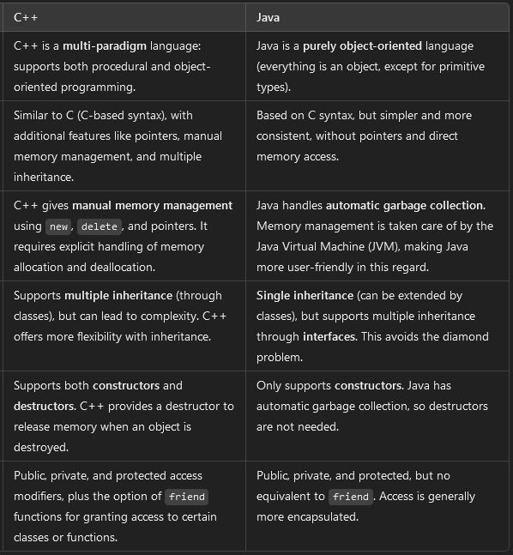
Syntax and Language Features

Slide 15
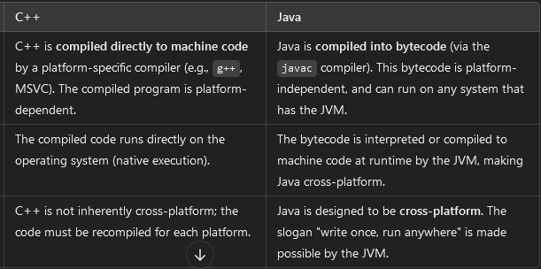
Compilation and Execution

Slide 16
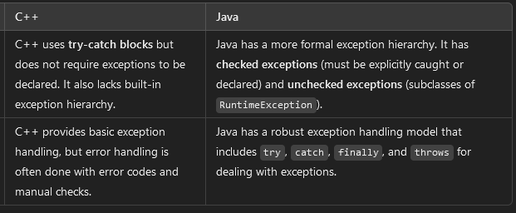
Exception Handling

Slide 17
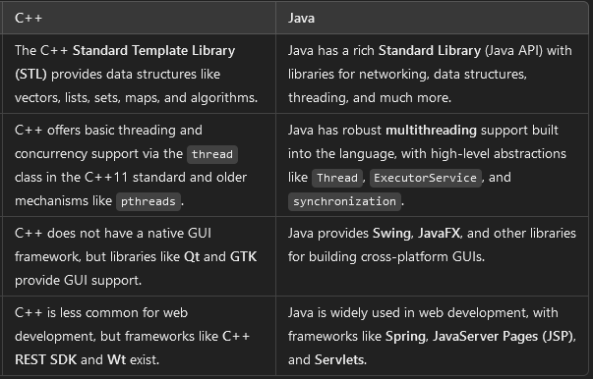
Standard Libraries and Frameworks

Slide 18
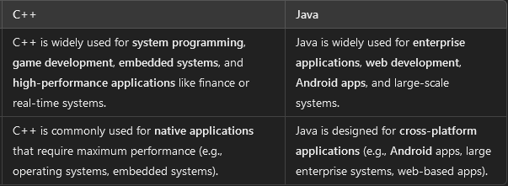
Use Cases and Application Domains

Slide 19
Classes
To create a class, use the keyword class.
Syntax
public class Main
{
int x = 5;
}

Slide 20
Object
In Java, an object is created from a class. We have already created the class named Main, so now we can use this to create objects.
To create an object of Main, specify the class name, followed by the object name, and use the keyword new
Syntax
public class Main {
int x = 5;
public static void main(String[] args) {
Main myObj = new Main();
System.out.println(myObj.x);
}
}

